Slide 1


Annual Epidemiological Report
Vaccine uptake in junior infants and children aged between 4 and 5 years in Ireland, 2023/2024
4 in 1 vaccine (DTaP-IPV) uptake and Measles, Mumps, Rubella (MMR) vaccine uptake as reported by Local Health Offices (LHOs) to HPSC for the academic year 2023 - 2024
A report from the Vaccine Preventable Disease Team, HPSC¹
Report prepared by: Piaras O’Lorcain
^{Published: November 2025}
Published by:
Health Protection Surveillance Centre, 25-27 Middle Gardiner St, Dublin 1 Ireland.
t: +353 1 8765300
© Health Protection Surveillance Centre, 2025
Citation Text:
HSE Health Protection Surveillance Centre (2025). Vaccine uptake in junior infants and children aged between 4-5 years in Ireland, 2023/2024. Dublin.
Reproduction is authorised, provided source is acknowledged
¹The Vaccine Preventable Disease Team is part of the Health Protection Surveillance Centre, National Health Protection Office, Health Service Executive

Slide 2


4 in 1 vaccine
(DTaP-IPV)
MMR vaccine
What are the key messages in this report?
For the 2023/2024 school year, overall national uptake of the 4 in 1 (DTaP-IPV ) vaccine was 89.9%.
Between 2022/2023 and 2023/2024, 4 in 1 vaccine uptake among junior infants in schools in Local Health Office (LHOs) areas where HSE teams administered the vaccine increased from 90.0% to 90.5%*.
In LHOs where GPs administer the vaccine (Donegal and Sligo/Leitrim), uptake among children aged between 5 and 6 years increased from 80.3% to 83.4% between 2022/2023 and 2023/2024. An increase in uptake was observed in Donegal only.
For the 2023/2024 school year, overall national uptake of the MRR vaccine was 89.5%.
Between 2022/2023 and 2023/2024, MMR vaccine uptake among junior infants in schools in LHO areas where HSE teams administered the vaccine increased from 89.8% to 90.0%.
In LHOs where GPs administer the vaccine (Donegal and Sligo/Leitrim), uptake among children aged between 5 and 6 years increased from 80.4% to 83.5% between 2022/2023 and 2023/2024. This increase occurred in Donegal only.
In 2023/2024, uptake remained sub-optimal among junior infants (<95%), nationally, in all six Community Health Organisations (CHOs) and in all but five Local Health Offices (LHOs) (Limerick (4 in 1 / DTaP-IPV only), Tipperary North/East Limerick (MMR only) North Cork, Dublin South* and Dublin South East*).
Uptake less than 95% for these vaccines indicates vulnerability amongst children who have not availed of the vaccines aimed at preventing serious diseases (diphtheria, tetanus, pertussis, polio, measles, mumps, and rubella).
*CAVEAT:
In some areas vaccine uptake was recorded as >100%.
This is due to technical discrepancies in school denominators from those received from the Department of Education and operational data collected at the time of vaccine delivery by HSE school teams.
This report is based on primary school denominators issued by the Department to Education (DoE) and received by the School Immunisation System (SIS) team on 13/09/2024. In instances where uptake exceeds 100% denominators have been adjusted to equate an uptake capped at 100%.
Discrepancies in denominators provided by DoE compared to those collected on the day of vaccination may be due to changes in school enrolment, student migration between schools and/or areas throughout the academic year and number of students presenting for vaccination on the day.
Note:
The raw data used to develop the content of this report are available at the end of this power-point document in:
Appendix 1. Overall uptake of the DTaP-IPV and MMR vaccines in junior infants in Ireland by LHO during the 2023/2024 academic year
Appendix 2. Overall uptake of the DTaP-IPV and MMR vaccines in junior infants in Ireland by CHO during the 2023/2024 academic year
Appendix 3 Overall uptake of the DTaP-IPV and MMR vaccines in junior infants in Ireland by HSE Health Regions during the 2023/2024 academic year

Slide 3
The uptake statistics presented in this report are by the nine Community Healthcare Organisations (CHO) and 32 Local Health Offices (LHO).
Appendix 3 also presents a summary of data by HSE Health Regions.
DTaP-IPV* and MMR† vaccine booster doses are primarily administered by the HSE school immunisation teams to children in junior infant classes. However, in two LHOs in the North West (Donegal and Sligo/Leitrim) these vaccines are routinely administered by GP services to children aged 5-6 years. Since the 2011/2012 academic school year, data on uptake of DTaP-IPV and MMR vaccines have been collated nationally and were first published in January 2013. Since then, annual (academic year) reports based on data submissions from each LHO, are published on the HPSC website at
http://www.hpsc.ie/a-z/vaccinepreventable/vaccination/immunisationuptakestatistics/immunisationuptakestatisticsforjuniorinfants/.
Since 2015, all LHOs are asked to input data relating to the school based junior infant DTaP-IPV and MMR vaccine programme on to the National Immunisation Office’s (NIO) web-based HSE School Immunisation System (SIS). Apart from the two North Western LHOs where the vaccination programme is GP-led, all other LHOs now use SIS for recording these data, though a few also continue to maintain their own local information systems. In this report, data for the 2023/2024 academic year DTaP-IPV and MMR vaccination programme are provided, and uptake compared with previously reported data.
What background information is relevant when reading this report?
*DTaP-IPV = Diphtheria, Tetanus, acellular Pertussis and Polio vaccine, also known as the 4 in 1 vaccine
†MMR = Measles, Mumps and Rubella vaccine

Slide 4
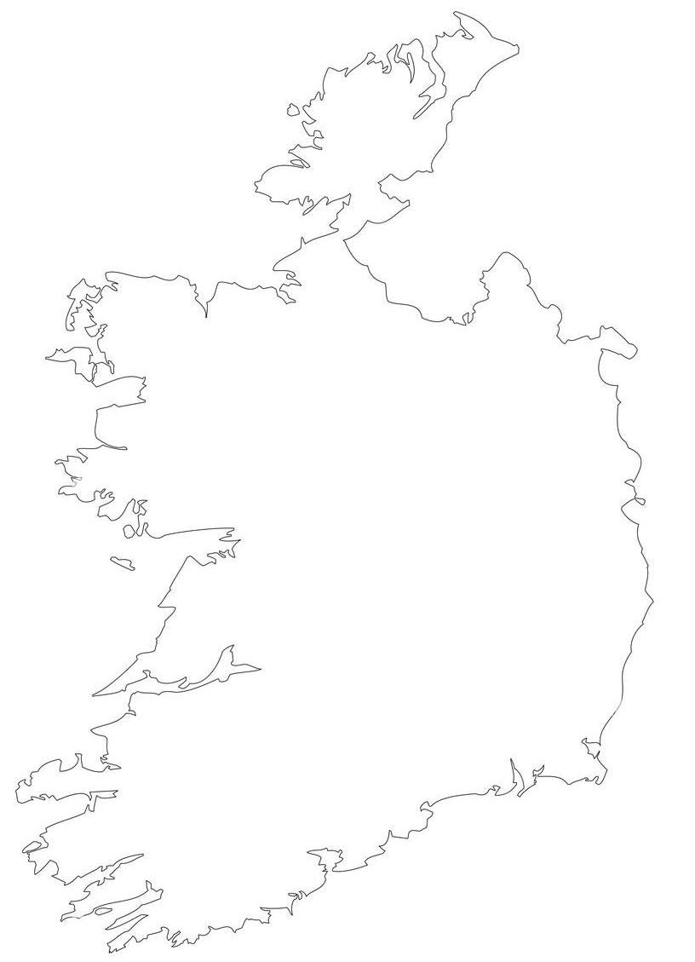
Results
Part 1 of 3
Figure 1 Estimated percentage uptake of the 4 in 1 (DTaP-IPV) vaccine nationally in Ireland, between 2011/2012 and 2023/2024 with 95 % Uptake Threshold Target
The national picture
In 2023/2024*, as was the case in all previous seasons since 2011/2012, the uptake of both the DTaP-IPV and MMR nationally failed to reach the 95% uptake target which is required for herd immunity§ to take effect within the population (Figures 1, 2).
§ 'Herd immunity', also known as 'population immunity', is defined as the indirect protection from an infectious disease , such as measles, that happens when a population is immune either through vaccination or immunity developed through previous infection.
Figure 2 Estimated percentage uptake of the MMR vaccine nationally in Ireland, between 2011/2012 and 2023/2024 with 95 % Uptake Threshold Target
* See Caveat on slide #2

Slide 5
Figure 3. Percentage uptake of the 4 in 1 (DTaP-IPV) vaccine in LHOs managed by HSE school teams in Ireland, between 2011/2012 and 2023/2024 with 95 % Uptake Threshold Target
Results
Part 2 of 3
4 in 1 vaccine
(DTaP-IPV)
Between 2022/2023 and 2023/2024*, the overall uptake of the DTaP-IPV vaccine in HSE-vaccine administered LHOs increased from 90.0% to 90.5%*. In 2023/2024, the average uptake among these 30* LHOs was 90.6% with a range from 79.2% in Dublin South West to 100% in Dublin South and Dublin South East*. Of the 30* HSE-vaccine administered LHOs, 15 reported an average uptake increase of 3.4%, and 15 reported an average decrease of 1.5% when compared to previous academic year. The largest reduction in uptake was reported by Dublin South City (4.8%) and the highest increase was reported by Dublin NorthWest (8.1%).
During the same timeframe, overall DTaP-IPV vaccine uptake in exclusively GP-vaccine administered LHOs (Donegal and Sligo/Leitrim) increased overall from 80.3% to 83.4%. Donegal reported an increase of 5.2%, whilst Sligo/Leitrim reported a fall of 0.2%.
Figure 4. Percentage uptake of the 4 in 1 (DTaP-IPV) vaccine in LHOs in the North West managed by GPs in Ireland, between 2011/2012 and 2023/2024 with 95 % Uptake Threshold Target
* See Caveat on slide #2

Slide 6
Results
Part 3 of 3
Figure 5. Percentage uptake of the MMR vaccine in LHOs managed by HSE school teams in Ireland, between 2011/2012 and 2023/2024 with 95 % Uptake Threshold Target
MMR vaccine
The overall uptake of the MMR vaccine between 2022/2023 and 2023/2024* in HSE-vaccine administered LHOs increased from 89.8% to 90.0%. In 2023/2024, the average uptake among 30* LHOs was 90.0% with a range from 78.1% in Dublin North Central to 100% in Dublin South and Dublin South East*. Of the 30* HSE-vaccine administered LHOs, 13 reported an average uptake increase of 3.3% and 19 reported an average decrease of 1.6%. The largest reduction in uptake was reported by Dublin South City (4.6%) and the highest increase was reported by Dublin NorthWest (7.7%).
Overall MMR vaccine uptake in exclusively GP-vaccine administered LHOs increased from 80.4% to 83.5% during the same timeframe. Donegal uptake increased by 5.0%, whilst Sligo/Leitrim uptake reduced by 0.1%.
Figure 6. Percentage uptake of the MMR vaccine in LHOs in the North West managed by GPs in Ireland, between 2011/2012 and 2023/2024 with 95 % Uptake Threshold Target
* See Caveat on slide #2

Slide 7
4 in 1 vaccine
(DTaP-IPV)
MMR vaccine
Nationally uptake for both vaccines, 4 in 1 and MMR, increased slightly between 2022/2023 and 2023/2024
  In LHO areas where the vaccine was administered by HSE teams in schools, uptake for both vaccines, 4 in 1 and MMR, increased marginally, but this was after rounding down the uptake figures for two HSE administrative LHOs in CHO 6/Area C/HSE Dublin and South East to 100% from >100%*.
  The improvement in the figures in GP-vaccine administered LHOs in 2023/2024 is due to an increase in uptake in Donegal.
Recent annual data would suggest that overall uptake remains relatively unchanged in both LHO areas where the vaccine was administered by HSE teams in schools and also in LHOs in the North West where the vaccine was administered by GPs.
  Overall uptake levels nationally however, remains well below the 95% target level for herd immunity recommended by the WHO.
  Uptake less than 95% for these vaccines indicates vulnerability amongst the children who have not availed of the vaccines aimed at preventing serious diseases (diphtheria, tetanus, pertussis, polio, measles, mumps, and rubella).
  95% coverage is needed to prevent outbreaks, avert unnecessary disease and deaths, and achieve WHO measles elimination goals**.
What can we interpret from the data in this report in this report?
Uptake less than 95% for these vaccines indicates vulnerability amongst children who have not availed of the vaccines aimed at preventing serious diseases (diphtheria, tetanus, pertussis, polio, measles, mumps, and rubella).
In 2023/2024, uptake remained sub-optimal among junior infants (<95%), nationally, all six Community Health Organisations (CHOs) and in all but three Local Health Offices (LHOs) (Limerick (4 in 1 only), Tipperary North/East Limerick (MMR only), North Cork, Dublin South* and Dublin South East*).
* See Caveat on slide #2
** https://www.who.int/news/item/15-07-2024-global-childhood-immunization-levels-stalled-in-2023-leaving-many-without-life-saving-protection

Slide 8
There are limitations in these data.
1. A small number of children may have received booster vaccines prior to school age.
The data presented here represent vaccines administered for these age cohorts. It is possible that some children may have received their booster doses prior to school age if they came from another jurisdiction or were vaccinated earlier than the normal schedule for other reasons (including travel, exposure to cases of these diseases). However, if this did occur, the proportion would be very small.
What do I need to know about how the data for this report was collected?
3. The uptake in CHO area 1 cannot be compared to the other eight CHO areas (areas 2 to 9).
The two GP-vaccine administered LHOs (Donegal and Sligo/Leitrim) are part of Community Health Organisation (CHO) area 1, which also includes the HSE-vaccine administered LHO Cavan/Monaghan. However, to estimate uptake at a national level, the cohorts for Cavan/Monaghan, Donegal and Sligo/Leitrim have been combined.
In 2023/2024, vaccines were delivered in 30 LHOs by HSE school teams only and in two LHOs based in the North West by GPs only. In regions where vaccines are administered routinely by HSE Schools teams, there may be a small number of children who receive vaccination from their GPs, these are not captured on the Schools Immunisation System (SIS) and so are not included in this report.
2. The different ways that target populations have been defined in the HSE- and GP- vaccine administered LHOs has meant that a national uptake for either vaccine cannot be accurately calculated.
For the 2023 /2024 academic year, the target population in HSE-vaccine administered LHOs was all children in junior infants, on the school register on the 30th September 2023. For GP-vaccine administered LHOs, the target population was all children born between the 1st September 2017 and 31st August 2018.
4. The adjusted reported uptake figures from Dublin South and Dublin South East LHO will have impacted on the overall result for the HSE-vaccine administered areas (specifically CHO6 and Area C) as well as nationally.
Process overview:
Uptake was monitored across all LHOs during the 2023/2024 academic year. Data from all HSE-vaccine administered LHOs are based on what was recorded on SIS by 9th October 2025.
All uptake data, provided by immunisation coordinators and other administrative staff were entered onto a MS-Excel database and compared to those reported for the previous 2022/2023 season.

Slide 9
Appendix 1
2023-2024 | Data as of 09/10/2025 |  |  | 4 in 1 |  |  | MMR
HSE Area | CHO | CCA Code | LHO | Birth Cohort | Total No. vaccinated | % Uptake | Birth Cohort | Total No. vaccinated | % Uptake
NE | CHO1 | CN/MN | Cavan/Monaghan | 2101 | 1831 | 87.1 | 2101 | 1818 | 86.5
NW | CHO1 | DL | Donegal | 2158 | 1812 | 84.0 | 2158 | 1802 | 83.5
NW | CHO1 | SO/LM | Sligo/Leitrim | 1440 | 1190 | 82.6 | 1440 | 1201 | 83.4
W | CHO2 | G | Galway | 3507 | 3206 | 91.4 | 3507 | 3223 | 91.9
W | CHO2 | MO | Mayo | 1751 | 1557 | 88.9 | 1751 | 1538 | 87.8
W | CHO2 | RN | Roscommon | 922 | 807 | 87.5 | 922 | 797 | 86.4
MW | CHO3 | CE | Clare | 1588 | 1412 | 88.9 | 1588 | 1411 | 88.9
MW | CHO3 | L | Limerick | 1839 | 1767 | 96.1 | 1839 | 1760 | 95.7
MW | CHO3 | TN | Tipperary North/East Limerick | 1747 | 1655 | 94.7 | 1747 | 1660 | 95.0
S | CHO4 | KY | Kerry | 1867 | 1603 | 85.9 | 1867 | 1603 | 85.9
S | CHO4 | NC | North Cork | 1261 | 1220 | 96.7 | 1261 | 1211 | 96.0
S | CHO4 | NSL | North Lee - Cork | 2180 | 2031 | 93.2 | 2180 | 2019 | 92.6
S | CHO4 | NSL | South Lee - Cork | 2841 | 2677 | 94.2 | 2841 | 2659 | 93.6
S | CHO4 | WC | West Cork | 745 | 675 | 90.6 | 745 | 668 | 89.7
SE | CHO5 | CW/KK | Carlow/Kilkenny | 1828 | 1723 | 94.3 | 1828 | 1709 | 93.5
SE | CHO5 | TS | Tipperary South | 1289 | 1181 | 91.6 | 1289 | 1168 | 90.6
SE | CHO5 | WD | Waterford | 1755 | 1635 | 93.2 | 1755 | 1585 | 90.3
SE | CHO5 | WX | Wexford | 1974 | 1780 | 90.2 | 1974 | 1783 | 90.3
E | CHO6 | CCA1 | Dublin South | 1481 | 1481 | 100.0 | 1481 | 1481 | 100.0
E | CHO6 | CCA2 | Dublin South East | 1408 | 1408 | 100.0 | 1408 | 1408 | 100.0
E | CHO6 | CCA10 | Wicklow | 1641 | 1556 | 94.8 | 1641 | 1546 | 94.2
E | CHO7 | CCA3 | Dublin South City | 1686 | 1480 | 87.8 | 1686 | 1469 | 87.1
E | CHO7 | CCA4 | Dublin South West | 1714 | 1358 | 79.2 | 1714 | 1346 | 78.5
E | CHO7 | CCA5 | Dublin West | 1984 | 1642 | 82.8 | 1984 | 1621 | 81.7
E | CHO7 | CCA9 | Kildare/West Wicklow | 3653 | 3402 | 93.1 | 3653 | 3410 | 93.3
M | CHO8 | LS/OY | Laois/Offaly | 2356 | 2151 | 91.3 | 2356 | 2109 | 89.5
M | CHO8 | LD/WH | Longford/Westmeath | 1866 | 1691 | 90.6 | 1866 | 1695 | 90.8
NE | CHO8 | LH | Louth | 1836 | 1614 | 87.9 | 1836 | 1608 | 87.6
NE | CHO8 | MH | Meath | 2950 | 2662 | 90.2 | 2950 | 2661 | 90.2
E | CHO9 | CCA8 | Dublin North | 3618 | 3218 | 88.9 | 3618 | 3191 | 88.2
E | CHO9 | CCA7 | Dublin North Central | 1446 | 1147 | 79.3 | 1446 | 1130 | 78.1
E | CHO9 | CCA6 | Dublin North West | 2829 | 2432 | 86.0 | 2829 | 2417 | 85.4
 |  |  | Homeschooled | 166 | 36 | 21.7 | 166 | 30 | 18.1
 |  |  | NSL | 5021 | 4708 | 93.8 | 5021 | 4678 | 93.2
 |  |  | HSE area Only | 59663 | 54002 | 90.5 | 59663 | 53704 | 90.0
 |  |  | GP area Only | 3598 | 3002 | 83.4 | 3598 | 3003 | 83.5
 |  |  | Total including homeschooled | 63427 | 57040 | 89.9 | 63427 | 56737 | 89.5
Overall uptake of the DTaP-IPV and MMR vaccines in junior infants in Ireland by LHO during the 2023/2024 academic year
Notes:
GP=Vaccine administered by GPs in these areas;
HSE=Vaccine administered by HSE public health personnel in these areas;
Target Population in 30 LHOs: All children in Junior Infants on the school register in LHO on 30th September 2023 for the 2023/2024 academic year;
Target Population in 2 LHOs: All children born between 01/09/2017 and 31/08/2018;
The proportion of uptake attributable to home schooled children in HSE administered LHOs can now be captured on SIS and in 2023/2024 it accounted for just over 0.3% of the birth cohort for each vaccine.
* See Caveat on slide #2

Slide 10
Appendix 2
2023/2024 Data as of 09/10/2025 | 4 in 1 |  |  | MMR
Community Health Organisation | Birth Cohort | Total No. vaccinated | % Uptake | Birth Cohort | Total No. vaccinated | % Uptake
CHO1 | 5699 | 4833 | 84.8 | 5699 | 4821 | 84.6
CHO2 | 6180 | 5570 | 90.1 | 6180 | 5558 | 89.9
CHO3 | 5174 | 4834 | 93.4 | 5174 | 4831 | 93.4
CHO4 | 8894 | 8206 | 92.3 | 8894 | 8160 | 91.7
CHO5 | 6846 | 6319 | 92.3 | 6846 | 6245 | 91.2
CHO6 | 4530 | 4445 | 98.1 | 4530 | 4435 | 97.9
CHO7 | 9037 | 7882 | 87.2 | 9037 | 7846 | 86.8
CHO8 | 9008 | 8118 | 90.1 | 9008 | 8073 | 89.6
CHO9 | 7893 | 6797 | 86.1 | 7893 | 6738 | 85.4
Overall uptake of the DTaP-IPV and MMR vaccines in junior infants in Ireland by Community Health Organisation (CHO) during the 2023/2024 academic year
Notes:
Target Population in 30 LHOs: All children in Junior Infants on the school register in LHO on 30th September 2023 for the 2023/2024 academic year;
Target Population in 2 LHOs: All children born between 01/09/2017 and 31/08/2018; HSE Health Regions are: HSE Dublin and North East, HSE Dublin and Midlands, HSE Dublin and South East, HSE Mid West, HSE South West, HSE West and North West
* See Caveat on slide #2

Slide 11
Appendix 3
2023/2024 Data as of 09/10/2025 | 4 in 1 |  |  | MMR
HSE Region | Birth Cohort | Total No. vaccinated | % Uptake | Birth Cohort | Total No. vaccinated | % Uptake
Area A-Dublin and North East | 14780 | 12904 | 87.3 | 14780 | 12825 | 86.8
Area B-HSE Dublin and Midlands | 13259 | 11724 | 88.4 | 13259 | 11650 | 87.9
Area C-HSE Dublin and South East | 11376 | 10764 | 94.6 | 11376 | 10680 | 93.9
Area D-HSE South West | 8894 | 8206 | 92.3 | 8894 | 8160 | 91.7
Area E-HSE Midwest | 5174 | 4834 | 93.4 | 5174 | 4831 | 93.4
Area F-HSE West and North West | 9778 | 8572 | 87.7 | 9778 | 8561 | 87.6
Overall uptake of the DTaP-IPV and MMR vaccines in junior infants in Ireland by HSE Health Regions during the 2023/2024 academic year
Notes:
Target Population in 30 LHOs: All children in Junior Infants on the school register in LHO on 30th September 2023 for the 2023/2024 academic year;
Target Population in 2 LHOs: All children born between 01/09/2017 and 31/08/2018; HSE Health Regions are: HSE Dublin and North East, HSE Dublin and Midlands, HSE Dublin and South East, HSE Mid West, HSE South West, HSE West and North West
* See Caveat on slide #2

Slide 12
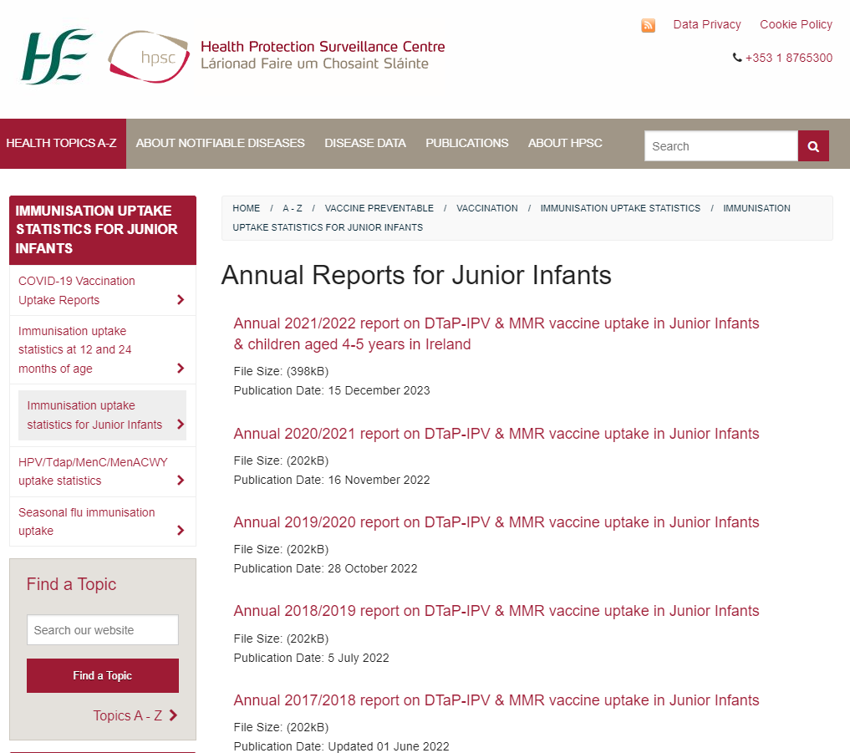
Acknowledgements
Many thanks to all HSE staff, Department of Education and Skills staff, staff in all educational settings, GPs and practice nurses, parents, and children/students, who implemented, participated in and supported all these vaccination programmes.
Further information available on HPSC website:
http://www.hpsc.ie/a-z/vaccinepreventable/vaccination/immunisationuptakestatistics/immunisationuptakestatisticsforjuniorinfants/

